Slide 1

An Enhancement of Moving Average Method with Bisection to Improve Accuracy in Trading Decision
Agustinus Noertjahyana – P031810014
Supervisor : ASSOC. PROF. DR. ZURAIDA ABAL ABAS
Co Supervisor : TS. DR. ZERATUL IZZAH MOHD. YUSOH

Slide 2
Publication
Implementing Bisection Method on Forex Trading Data to Early Diagnose of Inflection Point
Submitted to Telkomnika Q3
An Enhance of Moving Average with Bisection Method for Optimal Decision on Forex Trading
On Writing, will be submitted to IJAIN Q3

Slide 3
Methodology
RO1
RO2
RO3
To determine behavior of MOM and Bisection
To proposed enhanced approach of combining bisection methods and moving average
To validate the proposed approach
Knowing character of Moving Average Method (MOM)
Knowing character of Bisection Method
Dataset behavior on MOM and Bisection Method
Proof MOM as scalar result
Proof Bisection as scalar result
Combination MOM and Bisection based on character function
Proof the result using mathematical induction
Validation formula by expert in mathematic and trading
Validation result of computation
Validation of MOM with Bisection trends
Notes:
© Copyright PresentationGO.com – The free PowerPoint and Google Slides template library

Slide 4
Progress on RO2

Slide 5
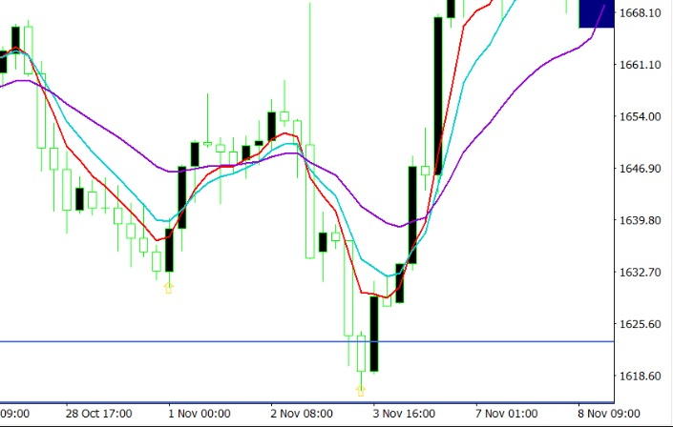
MA21
MA8
MA5

Slide 6
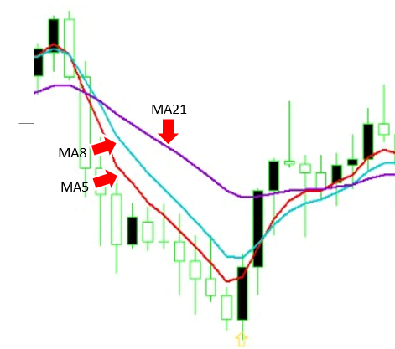
Find predicted function of MA5, MA8, MAS21 based on data per time interval.
Find predicted function of MA5, MA8, MAS21 based on data per time interval.
Find predicted function of MA5, MA8, MAS21 based on data per time interval.

